Slide 1

Quantum Algorithm for Solving LSE
Rahul Manavalan
Student of Computational Science and Engineering
Technische Universität München

Slide 2
Desiderata
Problem Definition
Classical Solutions
Problem Re-Definition
Quantum Solution
Insight
Algorithm
Subtleties
Exceptions to the Rule
Classical Simulation
Old Faithful
Results

Slide 3
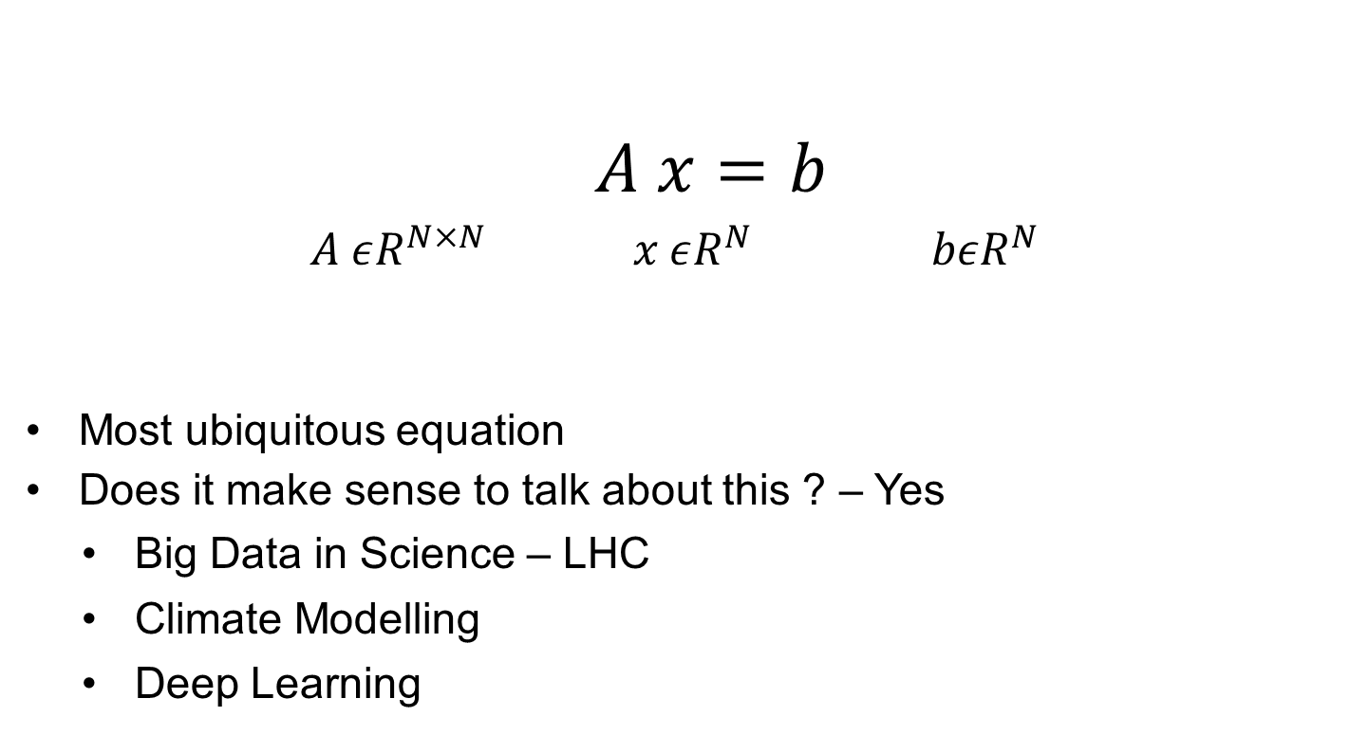
Problem Definition
$A x=b$
$A εR^{N×N} x εR^{N} bεR^{N}$
Most ubiquitous equation
Does it make sense to talk about this ? – Yes
Big Data in Science – LHC
Climate Modelling
Deep Learning

Slide 4
Classical Solutions
Dense Solvers and var.
Direct Solvers
Sparse Solvers and var.
Stationary Point Solvers
Iterative Solvers
Multigrid
Krylov Methods
Steepest Gradient Desc. , CG

Slide 5
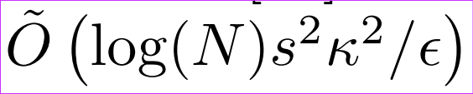
Quantum Solution
HHL Algorithm – 2009
Harrow Hassidim Lloyd.
Exponential Speedups
Quantum Simulation – RPF
Shor‘s Algorithm
Grover‘s Search
HHL

Slide 6
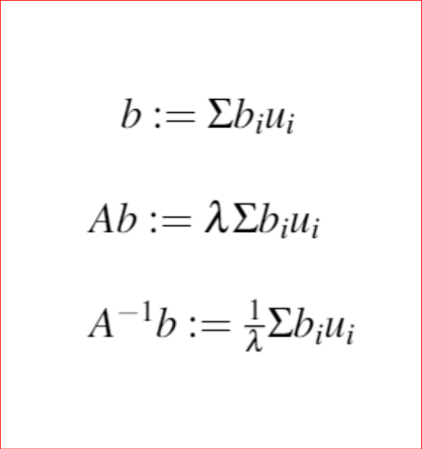
HHL : Insight
Any Matrix A and its inverse has reciprocating eigenvalues.
If there exists a quantum algorithm to compute λ and in turn 1/λ, we could compute x.

Slide 7
Problem Re-definition
How to determine eigenvalues of an arbitrary matrix A ?
Given a register of bitwise representations of a decimal number, how an we compute its reciprocal ?
Given a bitwise representation of a given normalized angle, how can we compute the sine of the angle ?

Slide 8
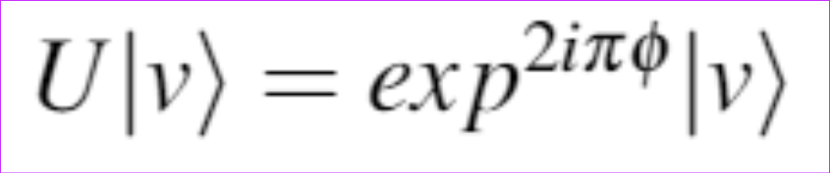
1) Eigenvalues of an arbitrary matrix A
Phase Estimation
Assuming that |v〉is an eigenvector of U and φ the corresponding phase angle.
In the real world, Unitary Matrices (Orthogonal Matrices) are hard to come by.
A is rarely unitary. => ?
Enter : Quantum Simulation … aka Hamiltonian Simulation.

Slide 9
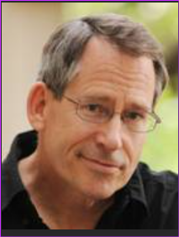
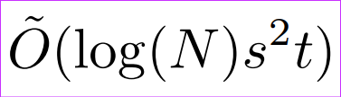
1) Eigenvalues of an arbitrary matrix A
John Preskill
Hamiltonian Simulation
Idea :
Convert your matrix A to a valid Hamiltonian H.
Allow a closed / open quantum system to evolve regulated by H.
Realization :
HARD ! : Sparse and Dense Hamiltonians -> Quantum Simulations.
Smaller ε and Faster τ are focal points.
Lie Trotter decomp / recomb ; Galaxy decomp ; Forrest decomp …..

Slide 10
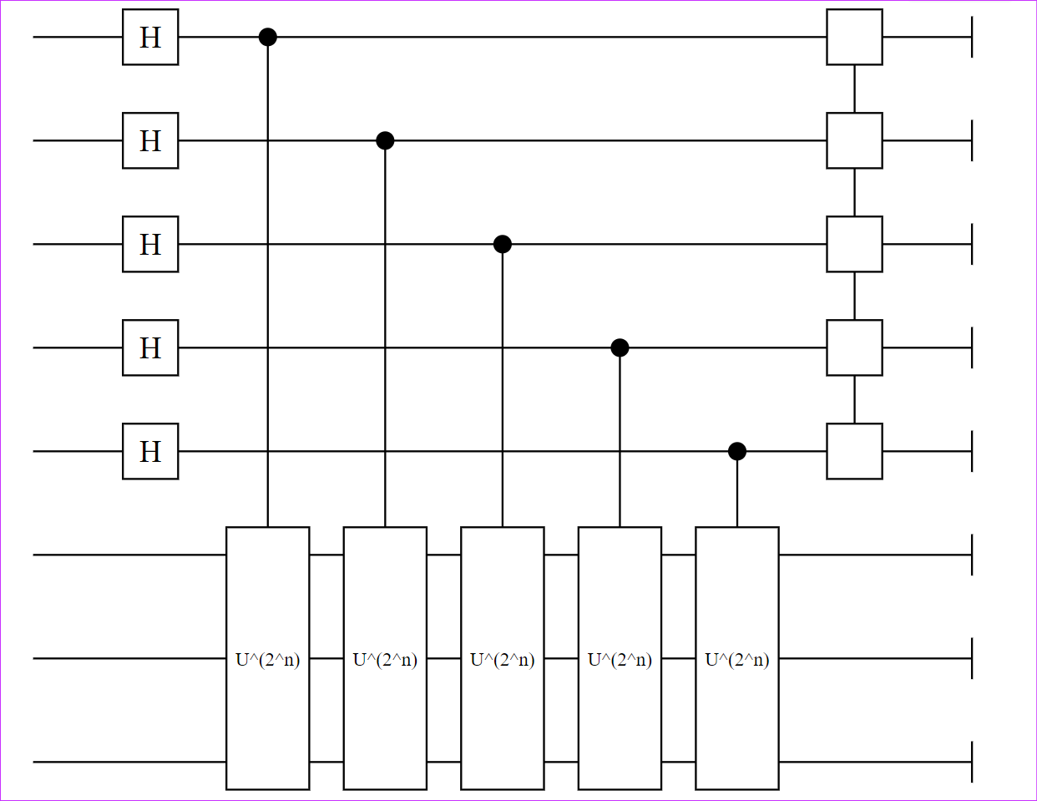
1) Eigenvalues of an arbitrary matrix A
Phase Estimation : Successive Controlled Hamiltonian Simulations
IQFT

Slide 11
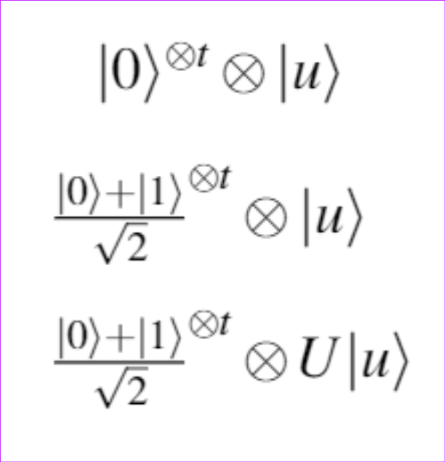
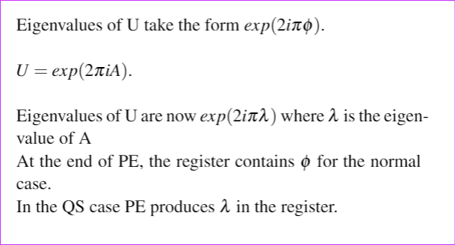
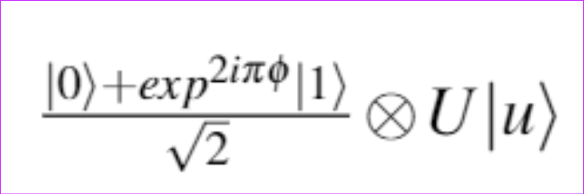
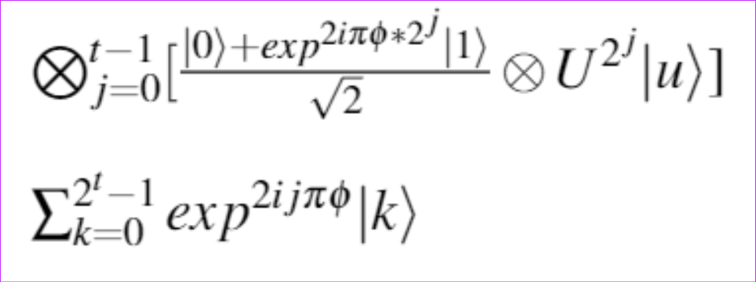
Phase Estimation – Crash Course

Slide 12
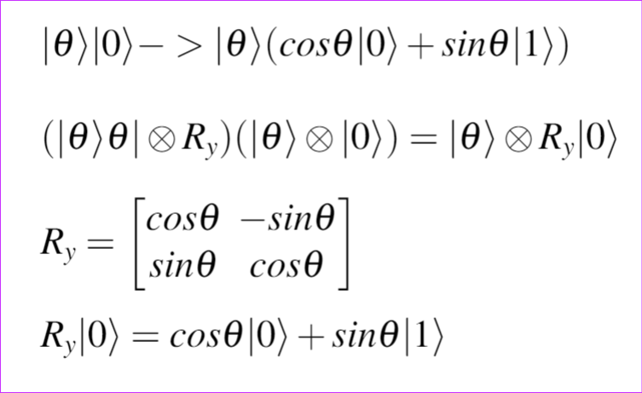
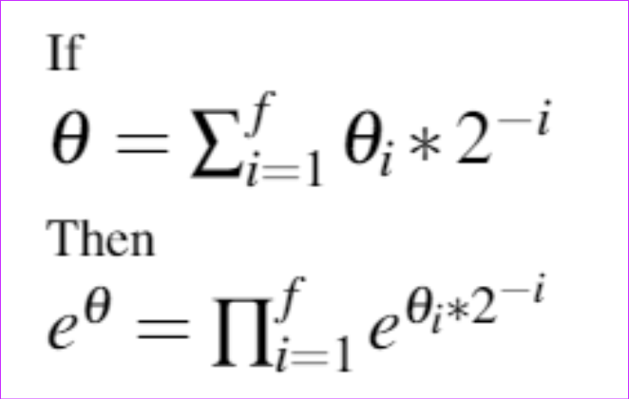
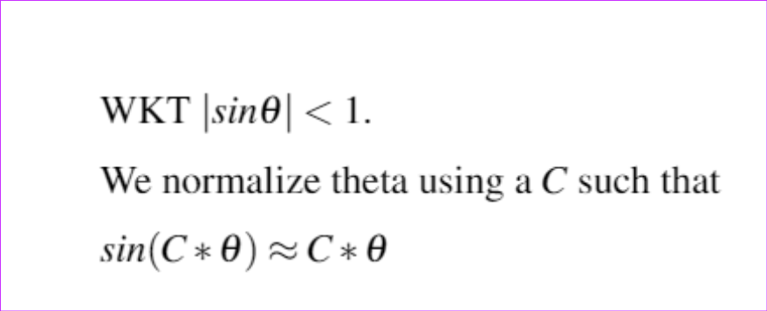

3) Sine of a bitstring – Controlled Rotation
Let $θ={θ.θ}_{1}θ_{2}θ_{3}…….θ_{f}$ be decimal representation
To transform $\left|θ\right\rangle → \sin{|θ|}$ , we use the following idea.

Slide 13
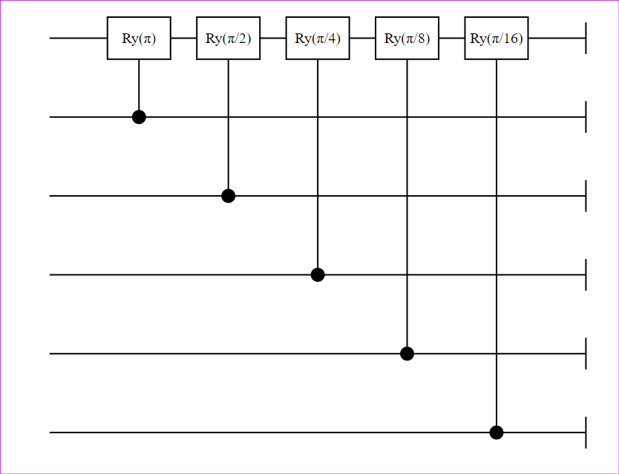
Sine of a Bitstring
Controlled Rotation : Eigenvalues a priori.

Slide 14
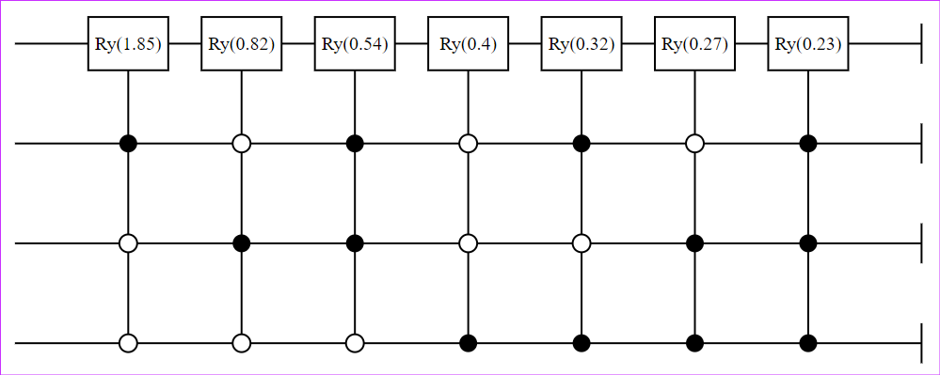
Sine of a Bitstring
Controlled Rotation : More robust

Slide 15









Algorithm – Components
$$R2$$
$$R2$$
$$R1$$
$$R1$$
Phase Estimation
I-Phase Estimation
Controlled Rotation
$$exp⁡\{iAt\}$$
$$exp⁡\{iAt\}$$
$$|b⟩$$
$$|x⟩$$
A – Hermitian , sparse , well conditioned.

Slide 16
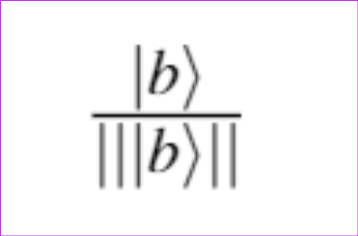
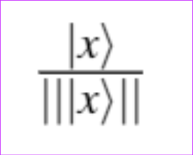

Brass Tacks – (i)
$$|b⟩$$
Encode using Amplitude encoding.
Amplitude embedding : roof(log(2,length(b))
Caveat : Solution is also amplitude embedded
`

Slide 17


Algorithm – Components
$$R2$$
$$R2$$
$$R1$$
$$R1$$
Phase Estimation
I-Phase Estimation
Controlled Rotation
$$|b⟩$$
$$exp⁡\{iAt\}$$
$$exp⁡\{iAt\}$$
$$|x⟩$$
A – Hermitian , sparse , well conditioned.

Slide 18
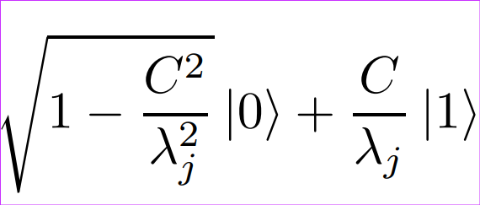

Brass Tacks – (v)
Controlled Rotation
$\left|λ\right\rangle$ is housed in Reg. A in a bitwise manner.
Add a ancilla qubit R2.
Prior to controlled rotation we reciprocate. i.e , transform $\left|λ\right\rangle →\left|\frac{1}{λ}\right\rangle$
If $\left|λ\right\rangle$ is not normalized, choose C such that $C<\min{λ_{j}}$.
State of R2 after CRot :

Slide 19

Algorithm – Components
$$R2$$
$$R2$$
$$R1$$
$$R1$$
Phase Estimation
I-Phase Estimation
Controlled Rotation
$$exp⁡\{iAt\}$$
$$exp⁡\{iAt\}$$
$$|b⟩$$
$$|x⟩$$
A – Hermitian , sparse , well conditioned.

Slide 20
Brass Tacks – (vi)
Un-compute PE
Throw away garbage in R1
Use Inverse Phase estimation
Runtime Significance
Error Significance

Slide 21
Algorithm – Components
$$R2$$
$$R2$$
$$R1$$
$$R1$$
Phase Estimation
I-Phase Estimation
Controlled Rotation
$$exp⁡\{iAt\}$$
$$exp⁡\{iAt\}$$
$$|b⟩$$
$$|x⟩$$
A – Hermitian , sparse , well conditioned.

Slide 22
HHL : Insight
Any Matrix A and its inverse has reciprocating eigenvalues.
If there exists a quantum algorithm to compute λ and in turn 1/λ, we could compute x.

Slide 23
Brass Tacks – (vii)
Measure ancilla qubit
Most boring yet crucial part of the algorithm
Measure ancilla
If we get 1 => success, solution at the base register
Else Back to square one
What could we measure with respect to?
Projectors
Compute Expectation

Slide 24


Algorithm – Components
$$C |1⟩$$
$$R2$$
$$R2$$
$$R1$$
$$R1$$
Phase Estimation
I-Phase Estimation
Controlled Rotation
$$exp⁡\{iAt\}$$
$$exp⁡\{iAt\}$$
$$|b⟩$$
$$|x⟩$$
$$\frac{1}{λ}|b⟩$$
A – Hermitian , sparse , well conditioned.

Slide 25
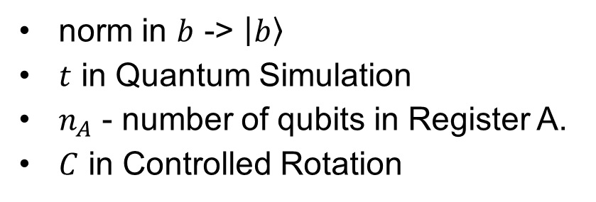
Caveats
norm in $b$ -> $\left|b\right\rangle$
$t$ in Quantum Simulation
$n_{A}$ - number of qubits in Register A.
$C$ in Controlled Rotation

Slide 26
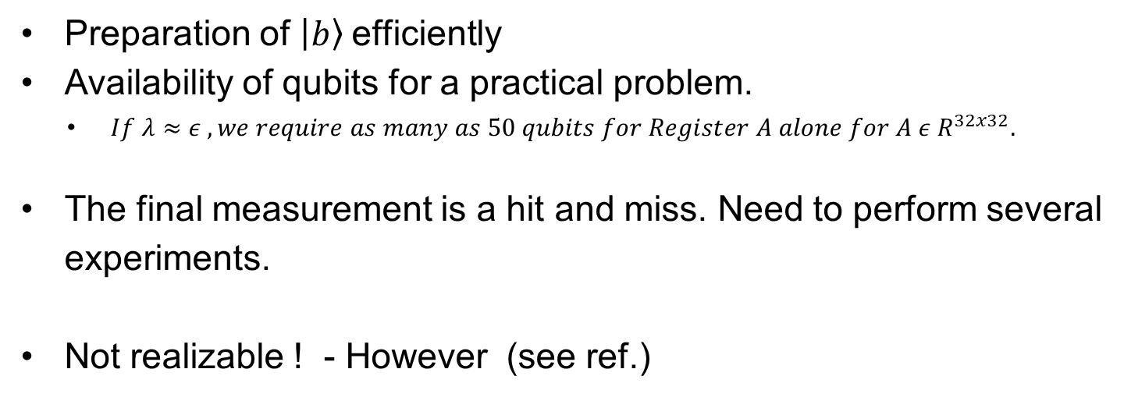
Difficulties in Actual Q.Computation
Preparation of $\left|b\right\rangle$efficiently
Availability of qubits for a practical problem.
$If λ≈ε , we require as many as 50 qubits for Register A alone for A ε R^{32x32}.$
The final measurement is a hit and miss. Need to perform several experiments.
Not realizable ! - However (see ref.)

Slide 27
1) Eigenvalues of an arbitrary matrix A
John Preskill
Hamiltonian Simulation
Idea :
Convert your matrix A to a valid Hamiltonian H.
Allow a closed / open quantum system to evolve regulated by H.
Realization :
HARD ! : Sparse and Dense Hamiltonians -> Quantum Simulations.
Smaller ε and Faster τ are focal points.
Lie Trotter decomp / recomb ; Galaxy decomp ; Forrest decomp …..

Slide 28
Exceptions to the Rule
Non Hermitian Matrices
Non Square Matrices
Dense Matrices
Non Invertible Matrices

Slide 29
Classical Simulation Frameworks
Yao.jl
Quaintum.jl
Qiskit Terra

Slide 30
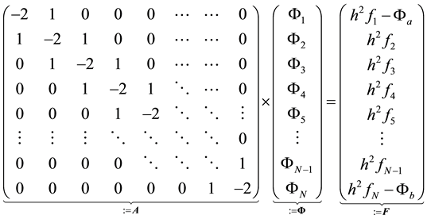

Old Faithful – Poisson Equation
$Δφ=f$ ; $x ε [a,b]$
$δΩ :φ\left(a\right)=0 ;φ\left(b\right)=0$
$f=ones(N)$
Finite Difference Method. HHL vs Julia „\“

Slide 31
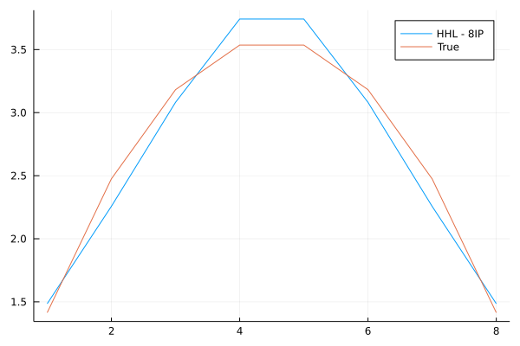
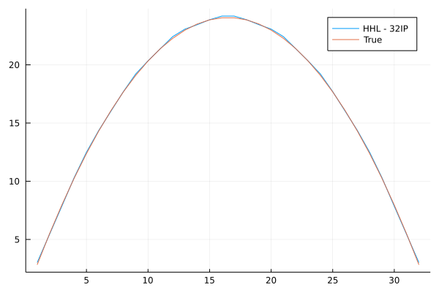
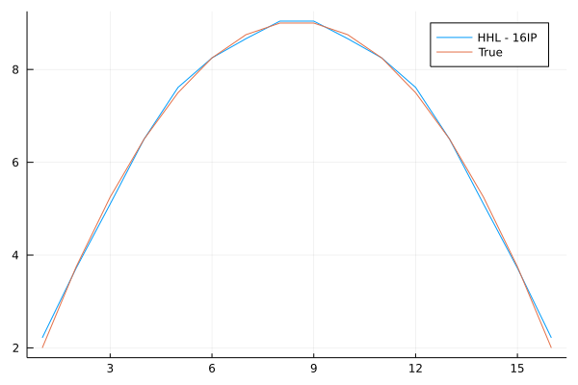
Results $n_\{λ$} = 12
1D

Slide 32
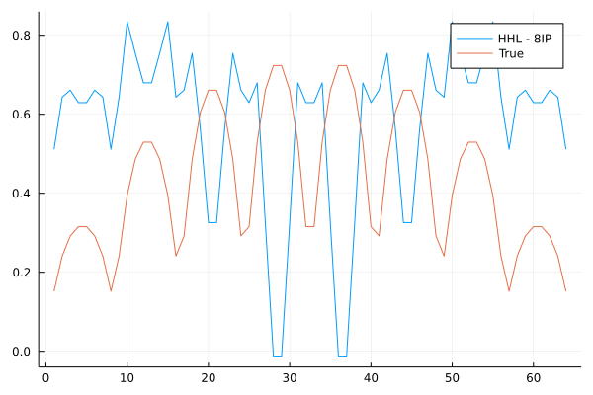
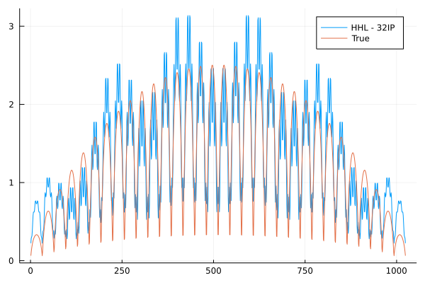
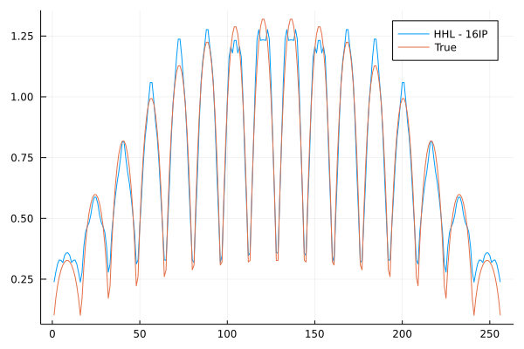
Results $n_\{λ$} = 12
2D

Slide 33
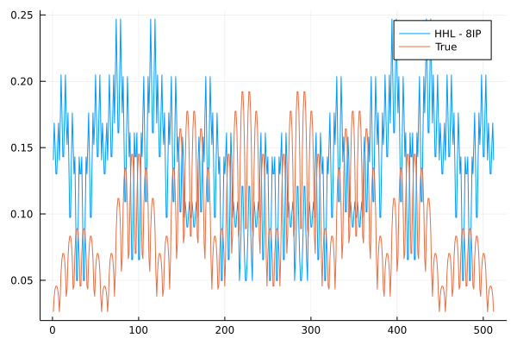
Results $n_\{λ$} = 12
3D

Slide 34
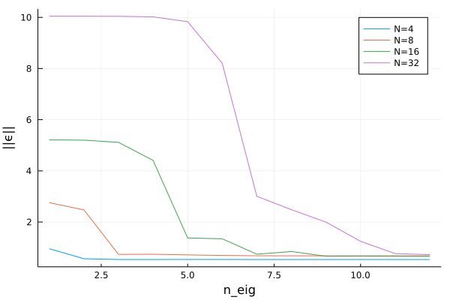
Results
Error Analysis – 1D

Slide 35
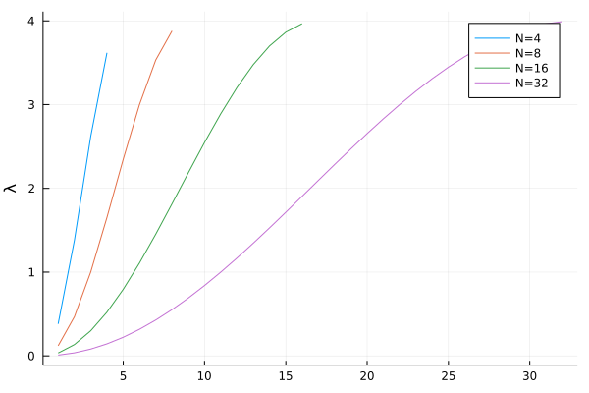
Results
Error Analysis – 1D – Inference : Relation to eigenvalues

Slide 36
More on HHL
Baseline Implementation
Rahul Manavalan / Solving the Heat Equation with the HHL Algorithm · GitLab (lrz.de)
Elaborations into the claims made in the HHL paper.
The Why of HHL.
https://dynamic-queries.medium.com/chapter-1-1-solutions-to-linear-systems-and-all-that-69dc73e02739

Slide 37
References
Read the fine print (nature.com) : Prelude
1301.2340.pdf (arxiv.org) : Box to Box Solution
1302.1210.pdf (arxiv.org) : Experimental Implementation albeit for a small system.
qiskit-terra/exact_reciprocal.py at a9289c085036002fa864b30edcd0b8ce066ea858 · Qiskit/qiskit-terra (github.com) : Exact reciprocal.
1802.08227.pdf (arxiv.org) : Primer
arXiv:0811.3171v3 [quant-ph] 30 Sep 2009 : Base Paper : Hard Read
1110.2232.pdf (arxiv.org) : Saved hours , quite comprehensive

